Slide 1

Target Enterprises LTD
ISDS 555
Presented to : Prof. Ester Gonzalez

Slide 2

Team 8
Apurva Desai
Bhaviya Gandani
Jaymin Joshi
Xinbei Zhu

Slide 3
Introduction
A small direct-mail order company started in 1993 which markets a variety of luxury, consumer and novelty items.
Main departments: Marketing, Accounting, Orders processing, Dispatch, Purchasing.
Target have several clerical staff who are responsible for ordering and receiving new goods from suppliers, process incoming orders and dispatch goods to customers.
The company is partially computerized, and uses packages for performing tasks like budget formation and management reporting.

Slide 4
Business Problem
Orders are operated manually
Document are in paper form
Ineffective use of customer database
Partially computerized system

Slide 5
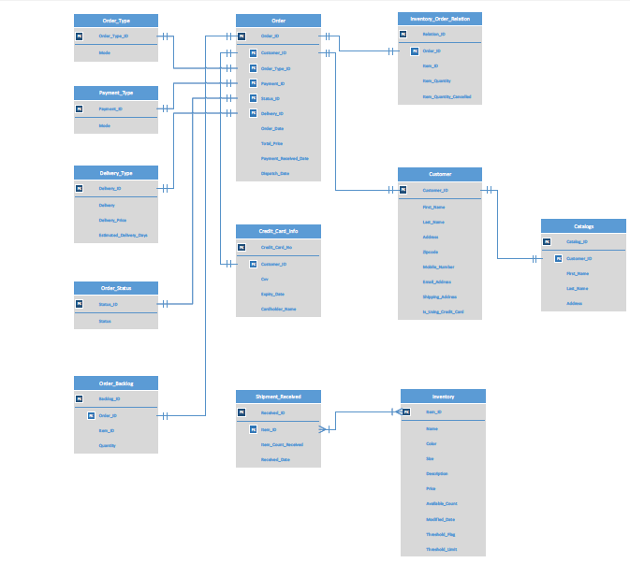
ER Diagram

Slide 6
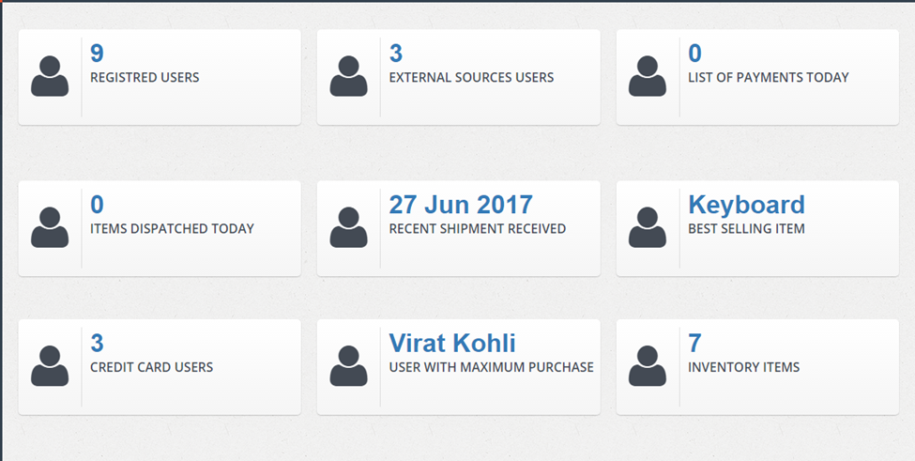
Web Application

Slide 7
SQL Queries
select count(customer_id) from customer;
select count(customer_id) from catalogs where customer_id=0;
select count(order_id) from orders where payment_received_date=@date;
select count(order_id) from orders where dispatch_date=@date;
select top 1 CONVERT(NVARCHAR, received_date, 106)
AS received_date from shipment_received order by received_date desc;
select top 1 i.name,count(o.item_id) from inventory i join inventory_order_relation o
on i.item_id=o.item_id group by i.name order by count(i.item_id) desc;
select count(customer_id) from customer where is_using_credit_card=1;
select top 1 c.first_name,c.last_name,c.customer_id,
count(o.order_id) from customer c join orders o on c.customer_id=o.customer_id
group by c.customer_id,c.first_name,c.last_name order by count(o.order_id) desc;
select count(item_id) from inventory;

Slide 8
Future Scope
Release 1.0 (August 2017)
1.1) Special discount feature
1.2) Product Rental feature
Release 2.0 (October 2017)
2.1) Online Application
2.2) Customer review feature
2.3) Similar items panel feature
Geographical Business expansion (January 2018)

Slide 9
Challenges
Creating a Web Application (in C# & .NET)
Integrating Application with Database (SQL)
Providing Logic Behind Code
Integrating data from different sources

Slide 10
Challenges
Creating a Web Application (in C# & .NET)
Integrating Application with Database (SQL)
Providing Logic Behind Code
Integrating data from different sources

Slide 11
Web Application Demo

Slide 12
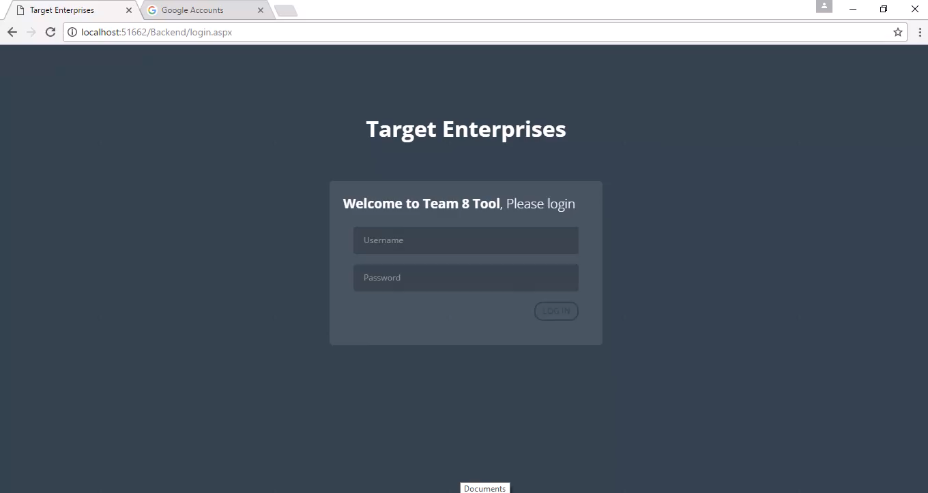

Slide 13
Conclusion
Problems were becoming crucial for Target due to the limitations of the company’s current system and so the managing director was seeking for a solution.
The new OMS enables Target to manage and review its inventory efficiently.
The new OMS saves computer storage space and saves postal cost due to removal of duplicate and redundant data.
The new system is electronically operated and managed.
All departments are computerized and integrated for an efficient work flow.

Slide 14
Thank You !

